Slide 1


EFFICIENT INDOOR CROWD
MANAGEMENT SYSTEM
Yash Anand Astitva Agarwal Adarsh Keshri Vansh Saluja
BS Sarandeep Sabut
2005420
2005718 20051122
20051285 20051397

Slide 2


TABLE OF CONTENTS
Introduction
Technology Used
Working
Implementation
Conclusion
Future Scope

Slide 3
INTRODUCTION
Efficient Indoor Crowd Management is a critical aspect of ensuring Public Safety and optimizing Crowd Control in various environments such as shopping malls, event venues, and transportation hubs.
This project aims to develop a sophisticated Crowd Management System using YOLO (You Only Look Once) Object Detection algorithm and Flask Web Framework.
The system utilizes Computer Vision techniques to detect and track individuals in real-time, enabling accurate crowd counting and monitoring.
The proposed system leverages the power of YOLO, an advanced object detection model, to accurately identify and track individuals within a video stream. By applying this algorithm to live camera feeds, the system is able to detect and count the number of people present in a given staircase.
The captured data is then processed and displayed in a User-friendly Web Interface created using Flask, allowing authorized personnel to monitor crowd levels and make informed decisions regarding crowd control measures.
Additionally, the system incorporates features like color-coded threshold alerts, where the display changes to red when the crowd density exceeds a predefined threshold, providing visual cues for immediate action and redirecting the crowd to the other staircase.
This combination of YOLO-based object detection and Flask web framework presents a powerful solution for Real-Time Crowd Monitoring and opens avenues for future research and advancements in the field.

Slide 4






TECHNOLOGY USED
JAVASCRIPT
OPENCV
HTML & CSS
PYTHON
YOLO

Slide 5



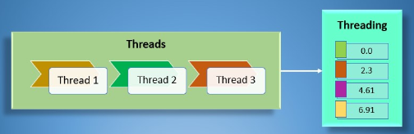
TECHNOLOGY USED
FLASK
CORS
NUMPY
Threading & Queueing

Slide 6
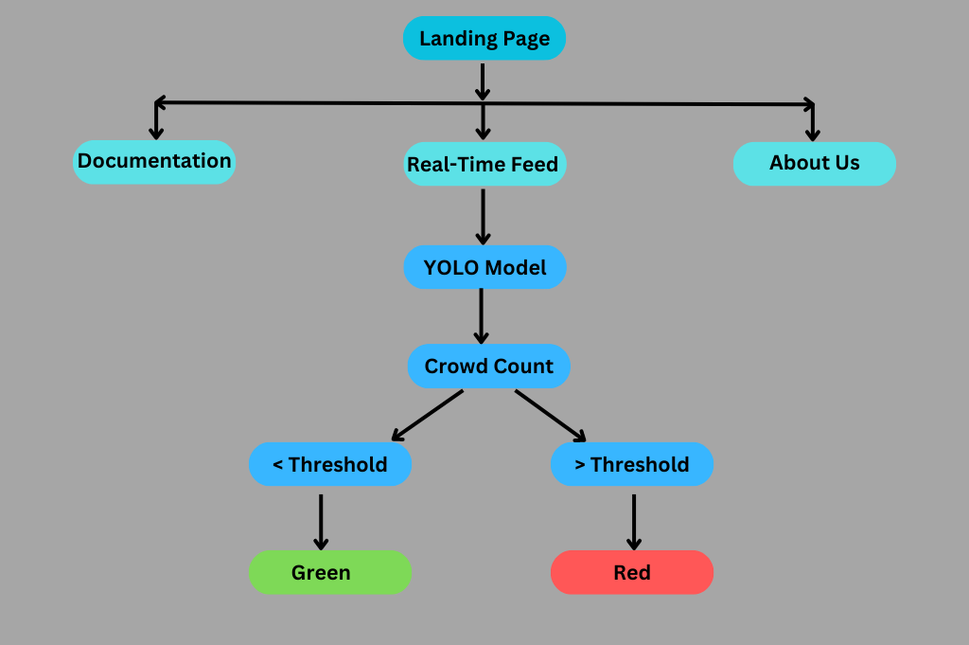
WORKING

Slide 7
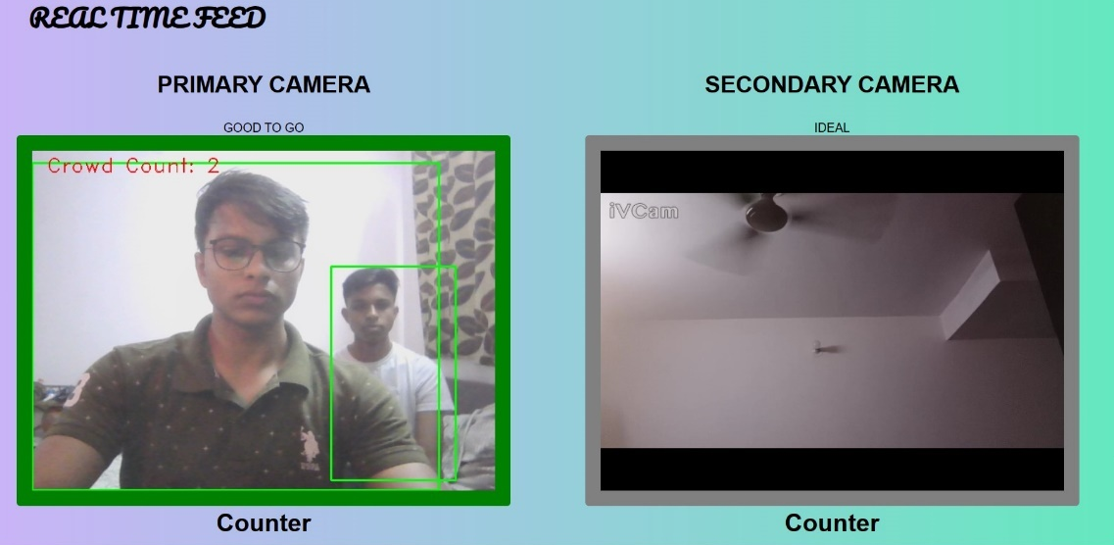

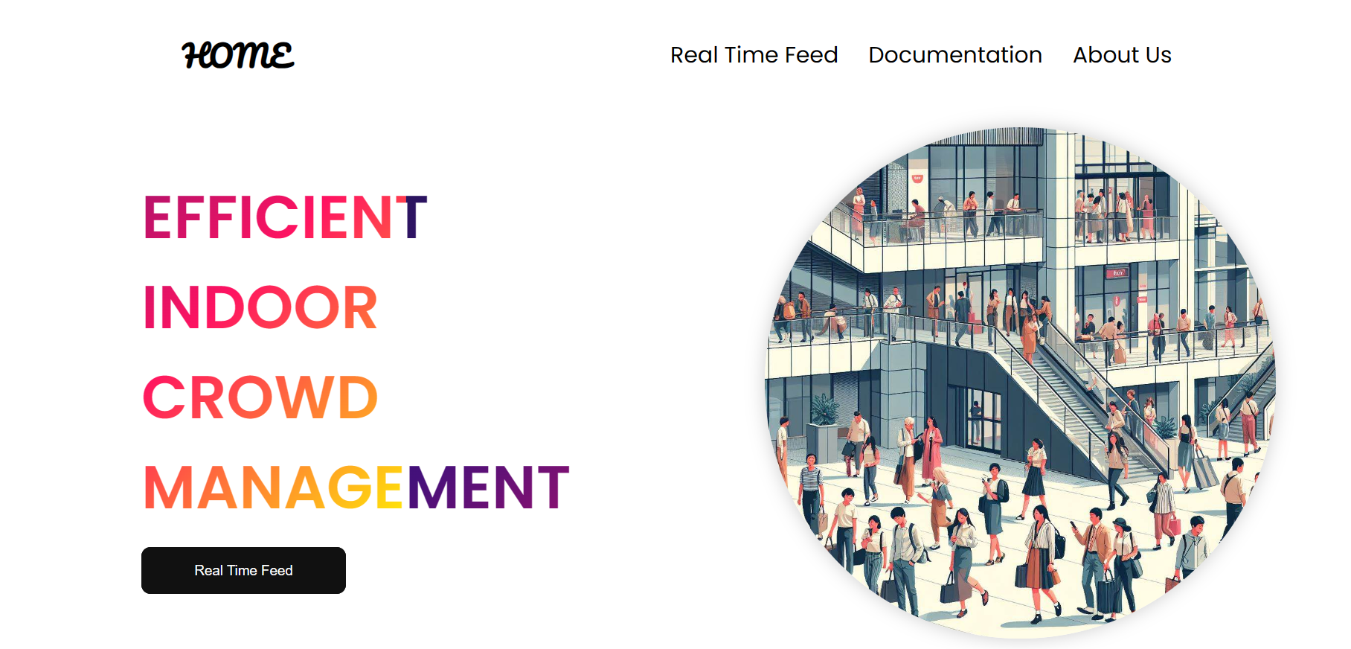
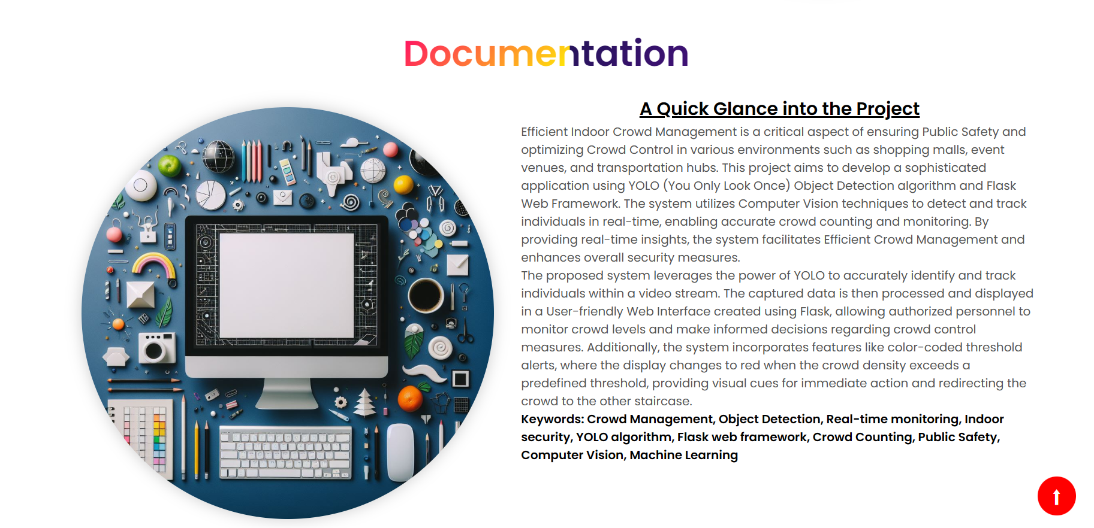
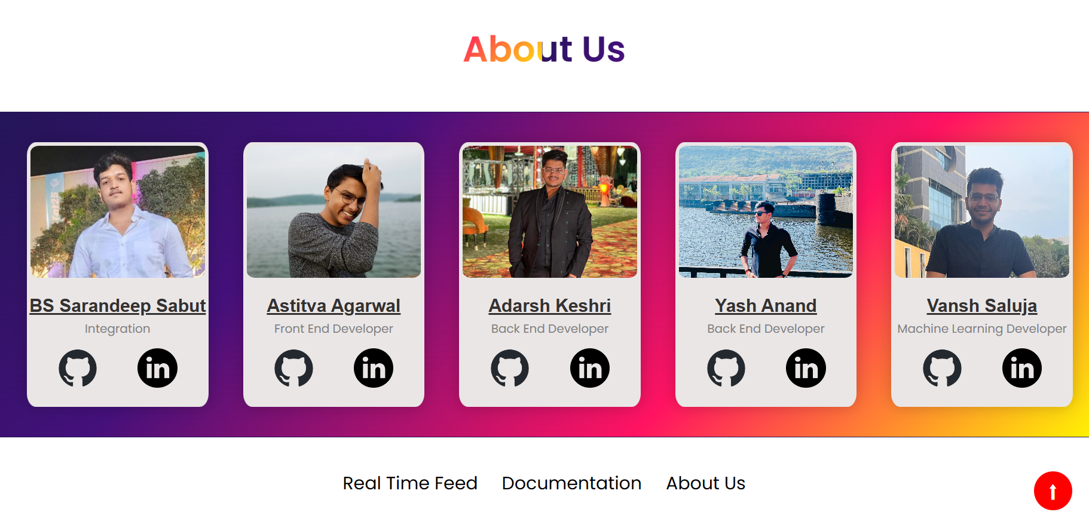
IMPLEMENTATION
Landing Page
Real Time Feed
Documentation
About Us

Slide 8
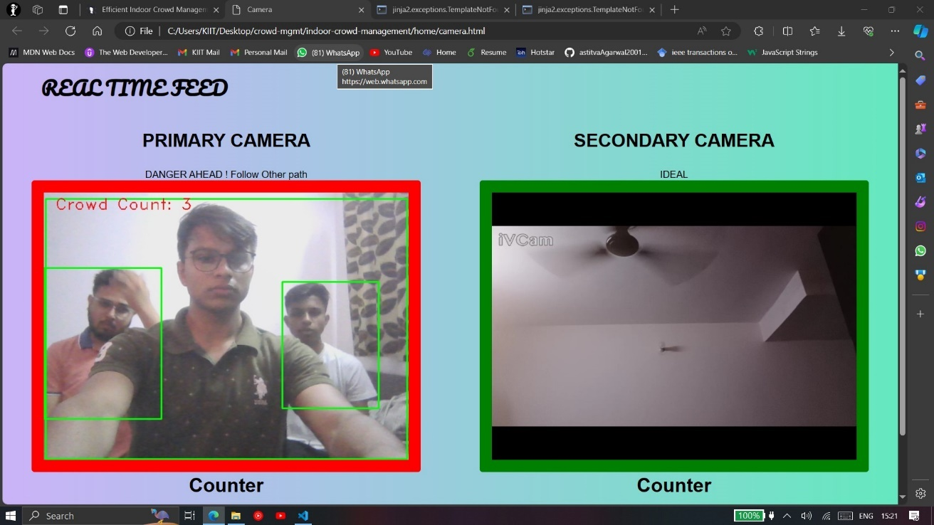
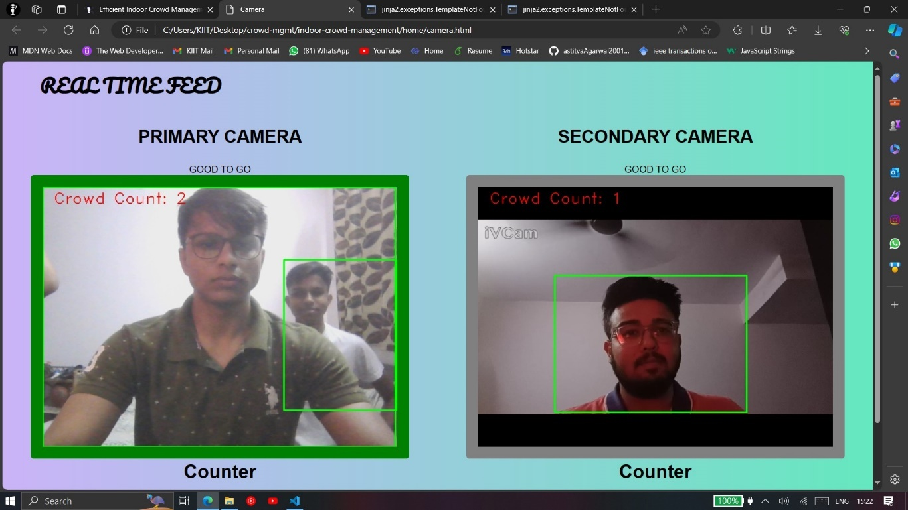
IMPLEMENTATION
This is the idle case where Primary exit (1) is Green and should be used and 2 is idle.
This is the case where crowd count in Primary exit (1) crosses the threshold and the crowd should be redirected to 2, so the color of Exit 1 changes to Red and 2 becomes Green.
Here, the crowd has been successfully redirected, so color changes back to Green.

Slide 9


CONCLUSION
The indoor crowd management project utilized YOLO, Flask, and JavaScript to monitor and manage crowds in real-time.
The project followed a systematic approach, including planning, analysis, design, and testing, and adhered to established coding standards and best practices.
Testing and verification followed ISO and IEEE standards and encompassed various crowd densities, lighting conditions, and camera angles.
The system effectively detected and counted individuals within a crowd, providing valuable insights into crowd dynamics and enabling efficient resource allocation and proactive decision-making.
The project has practical applications in various industries and contributes to the field of computer vision and crowd analysis, paving the way for enhanced crowd management strategies and safer indoor environments.

Slide 10
FUTURE
SCOPE
Exploring the integration of machine learning algorithms like deep reinforcement learning for more intelligent and adaptive crowd management strategies.
Investigating the feasibility of incorporating social distancing protocols and crowd density estimation techniques for enhanced safety measures.
Enhancing the system's capabilities by integrating multi-camera setups and leveraging advanced computer vision techniques for comprehensive crowd monitoring.
Implementing real-time data analytics and visualization tools to provide actionable insights for efficient decision-making and resource allocation.
Extending the project to outdoor environments and large-scale events, addressing the unique challenges and requirements associated with open spaces and diverse crowd dynamics.

Slide 11

THANK YOU

